Slide 1

Simulation of Concrete Cracking Pattern and Residual Mechanical Properties for ASR and DEF Expansion
The University of Tokyo
YUSHI MENG
Supervisor: Dr. Kohei Nagai
Notes:
20 sec
Today I’m going to talk about my research
About Simulation of Concrete cracking pattern
Combining
ASR and DEF expansion

Slide 2
CONTENTS
Background
Methodology
Simulation Model
Crack Pattern Result
Residual Mechanical Property Result
Conclusion
1
Notes:
20 sec
We will first go through background,
Then introduce our methodology and model,
Followed by simulation result on cracking pattern
And Mechanical Properties
Finally the conclusion

Slide 3

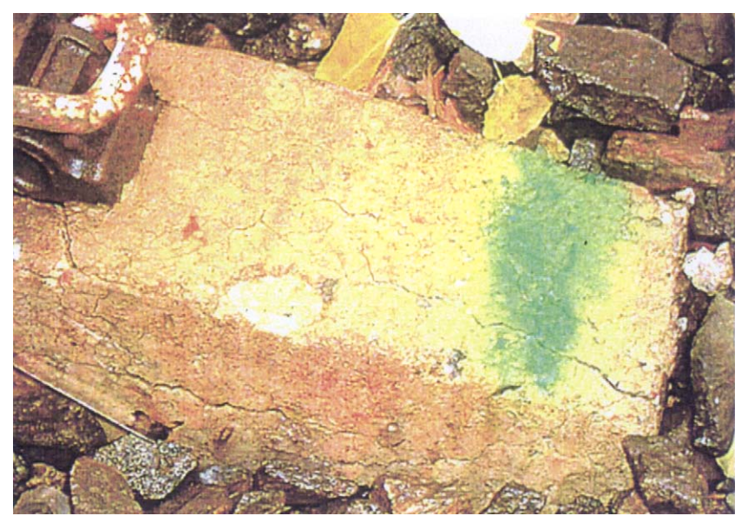

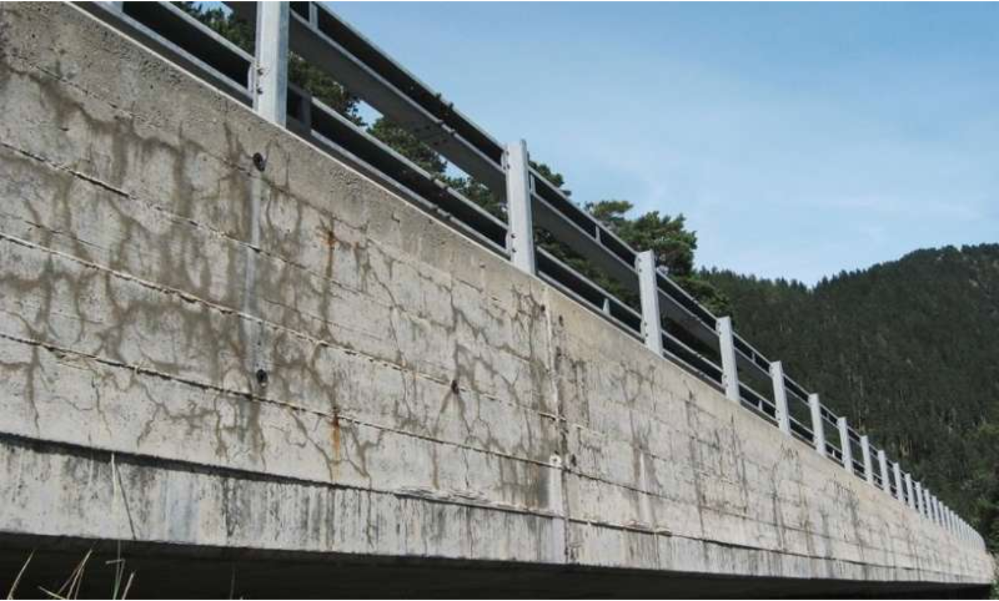
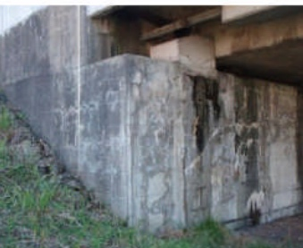
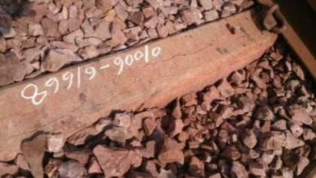
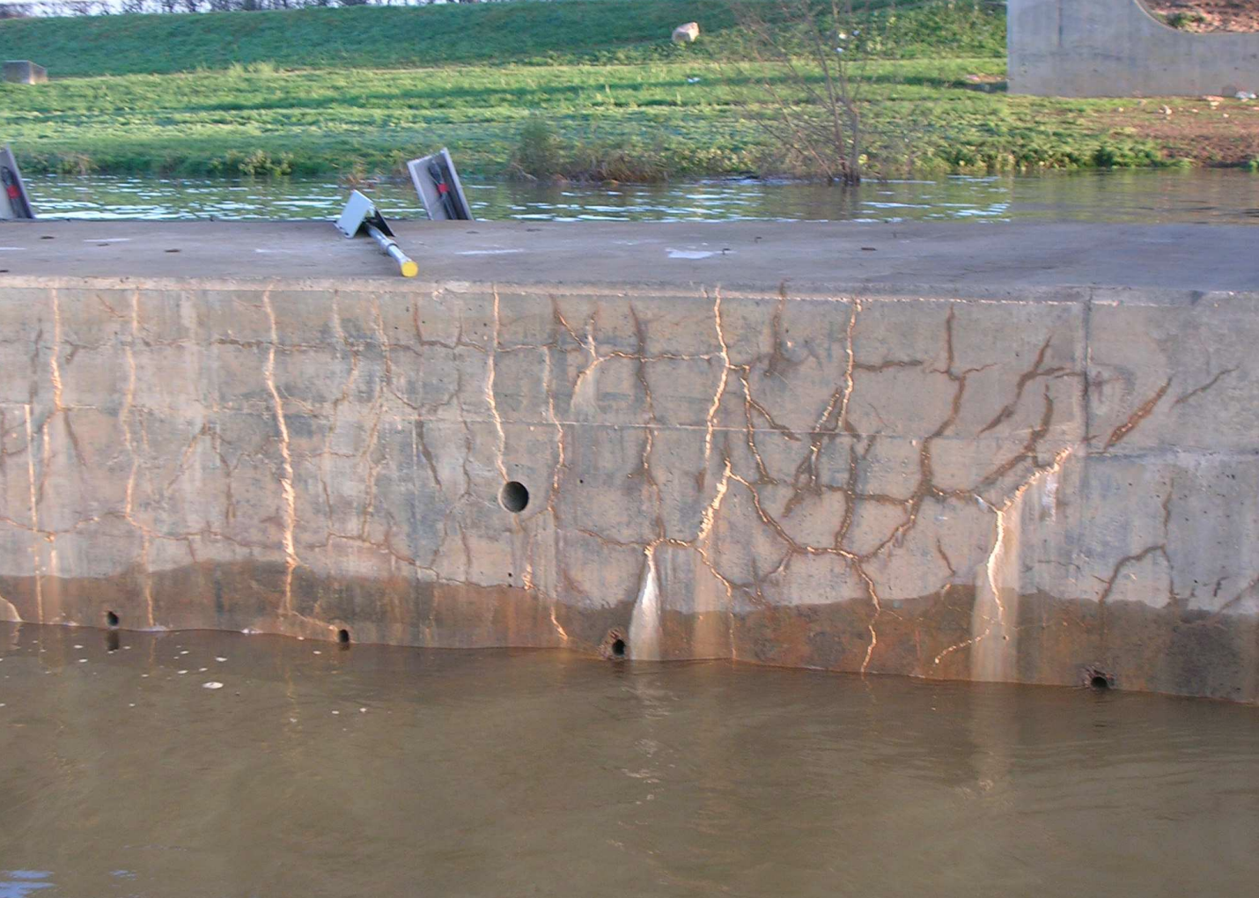
BACKGROUND
SWEDIAN
ALKALI-SILICA REACTION
DELAYED ETTRIGITE FORMATION
SWEDIAN
USA
JAPAN
INDIAN
FRANCE
Cracking
Similar
Characteristic
Map Cracking Pattern
ASR
DEF
Loss in Capacity
Safety Concern
Two Main Reason Causing Expansion and Safety Concern

Slide 4
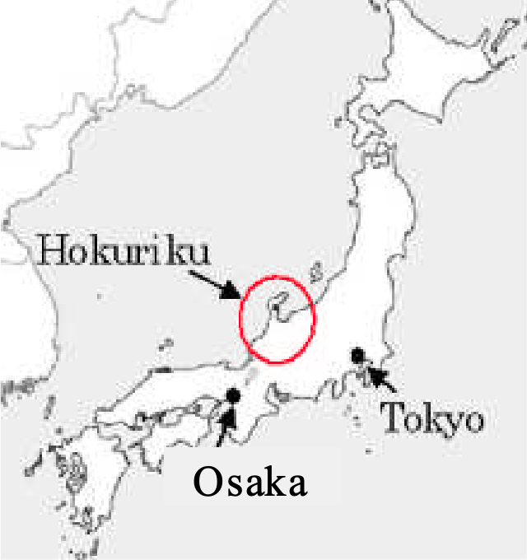
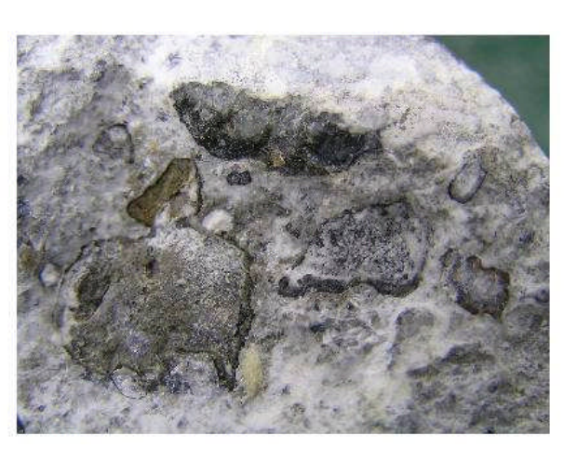
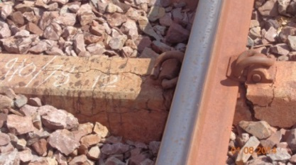
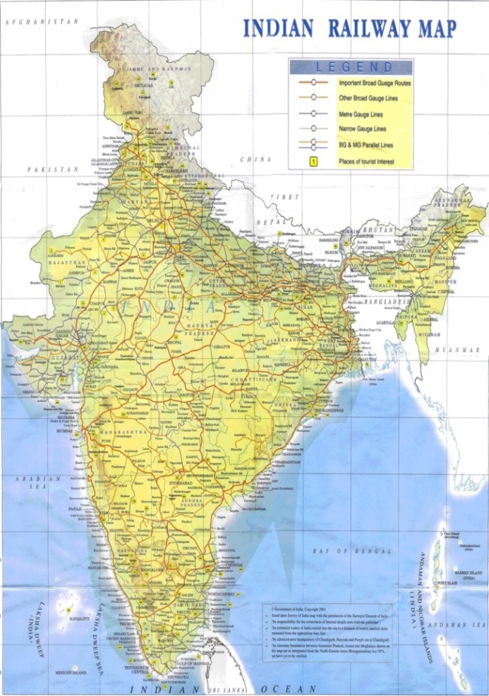
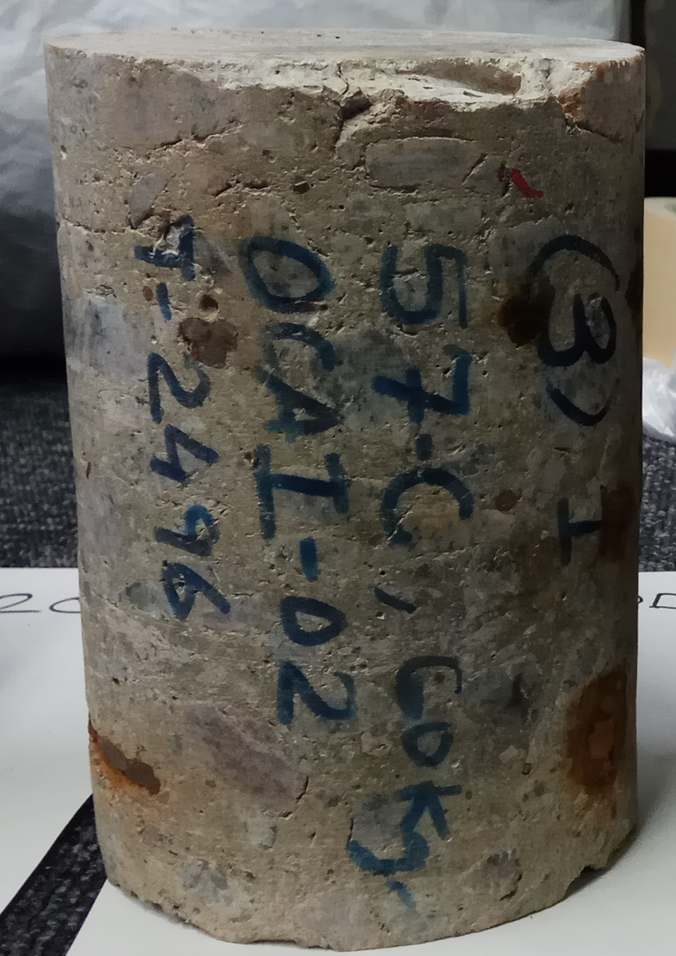
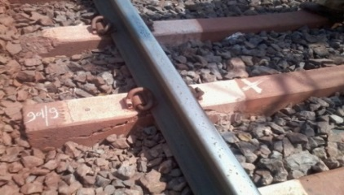
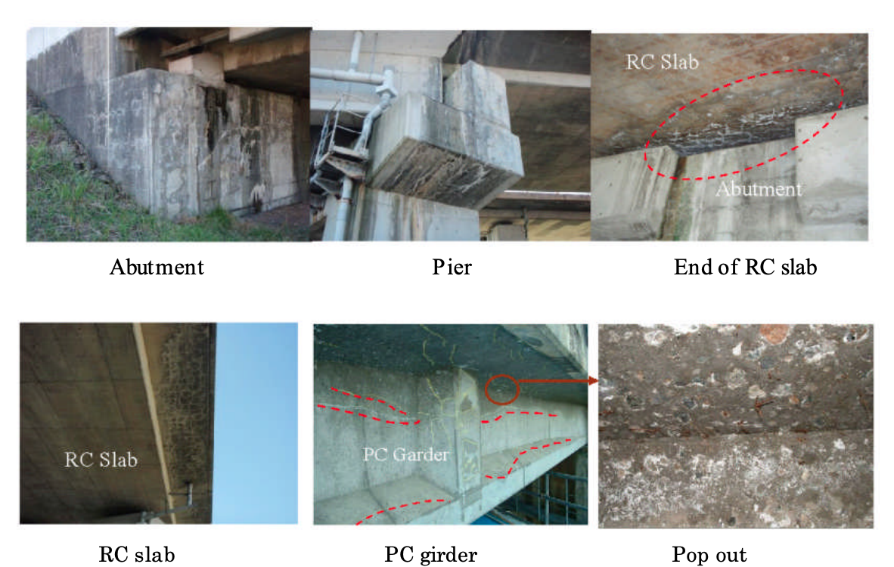
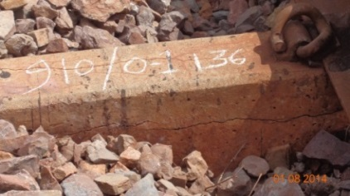
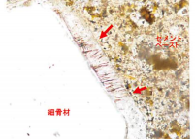
BACKGROUND
ASR EXPANSION
DEF EXPANSION
Damage in structure
ASR GEL
Loss in residual capacity
Safety Concern
Ettringite
ASR and DEF as Two Main Reason Causing Concrete Cracking
Losses in Residual Capacity Causing Concern in Industry
2
Notes:
30 sec
ASR and DEF, are two common reasons of concrete expansion,
actually causing us a lot of troubles,
For example, the ASR damaged bridge reported in Hokuriku, Japan
(Click)
And sever DEF damaged concrete sleeper, in Indian.
These kind of expansion not only bring us aesthetic concerns,
But also damage the residual capacity
Finally become a safety issue.

Slide 5

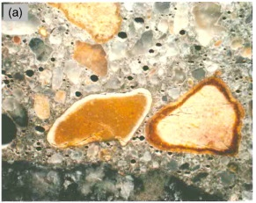
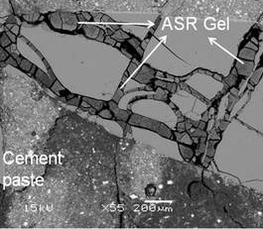
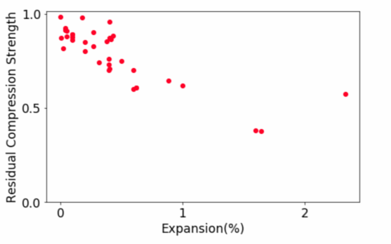
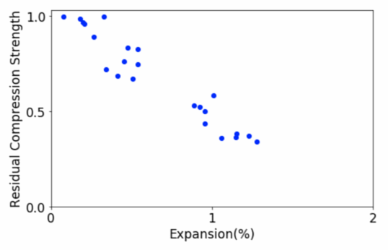
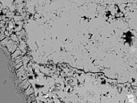
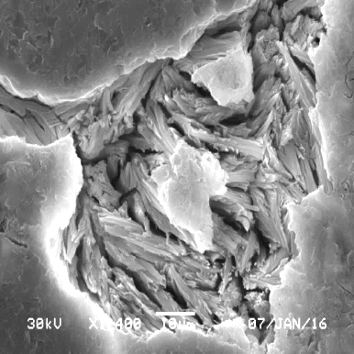
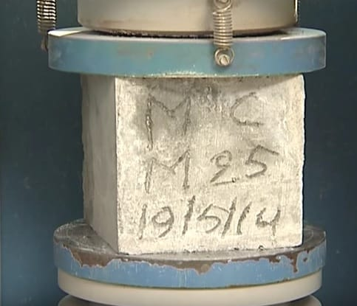
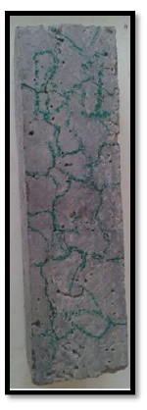
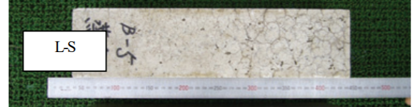
BACKGROUND
ASR
Residual Compressive Strength
Paste
100%
100%
Alkali–
Silica
Reaction
ASR
DEF
50%
50%
Aggregate
ASR GEL
EXPANSION
EXPANSION
1%
2%
1%
2%
DEF
Delayed Ettringite Formation
Compressive Strength
Decrease with
Increasing Expansion
Paste
ETTRINGITE
Similar Characteristic Map Cracking Pattern
Specimen of ASR expanded concrete, ALKANA, 2012
ASR
100mm
DEF
100mm
Specimens of DEF expanded concrete, KAWABATA et al., 2011
400mm
400mm
Similar in Cracking Pattern But Different in Cracking Mechanism
3
Notes:
50 sec
Though ASR and DEF both cause increasing in volume,
Their mechanisms are actually different.
(POINT AT EXPANDING INTERFACES)
Alkali silica reaction, introduce expansion by generate gel between mortar and ASR reactive aggregate,
Result in the volume increasing in whole structure
(Click)
While Delayed Ettringite formation happening in the paste, where mortar itself increase volume.
Their behaviors in meso scale actually pretty close,
Similar map cracking pattern can be formed.
(POINT AT CRACKS)
Their impact on Reduction of Mechanical properties are also different.
As experiments of ASR and DEF can take years, and the difficulties to analysis these two complicated phenomena quantitively,
Here we use simulation to

Slide 6
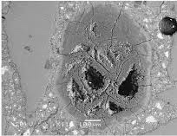
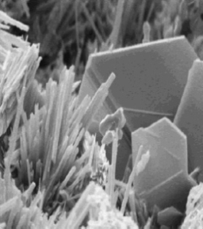
BACKGROUND
High Curing Temperature Delayed Ettringite Formation
Ettringite Formatted after Harden
Between Mortar vs. Mortar
ASR
OH⁻
of Alkali in Cement
Siliceous from Aggregate
Alkali-Silca
Gel
C-S-H GEL
Alkali–Silica Reaction
DEF
Primary ettringite
Primary
Ettringite
C₃A + Gypsum
Water
Water
Ettringite
Monosulfo-aluminate
C3A
Delayed Ettringite Formation
Primary ettringite is good for the concrete
Delayed Ettringite
T>70°C
Decomposition of
Primary Ettringite
Moist
Concrete
Reformation of Ettringite
Delayed ettringite causes deleterious expansion
Steel Constrain
Boundary Condition
Structural
Behavior
ASR
+
DEF
+
+
ASR and DEF, Combined with Steel Constrain and Boundary Condition,
Influenced the behavior of concrete

Slide 7
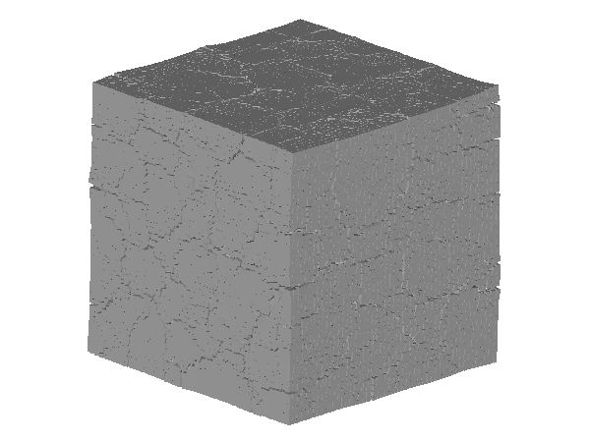
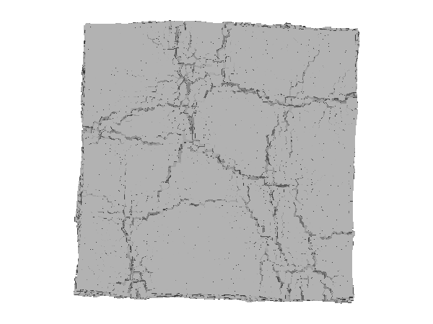
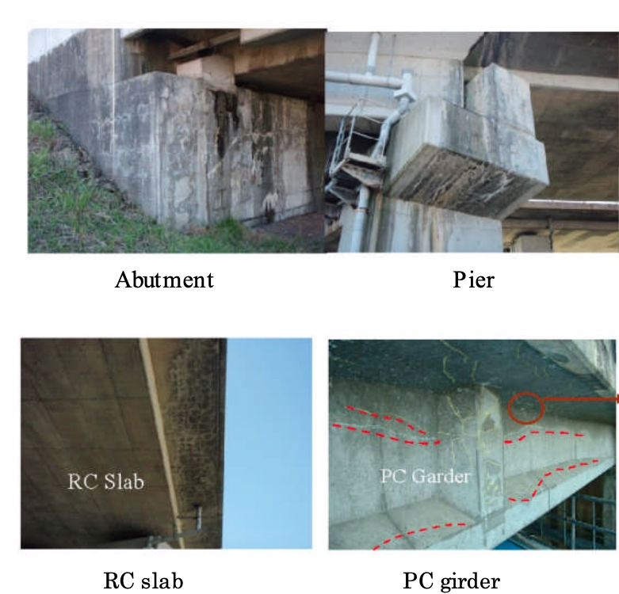
OBJECTIVE
Residual Capacity Prediction
Compressive Strength = ???
Expansion
Capacity
ASR
Residual
Mechanical
Properties
or
DEF
Keep or Rebuild ???
Structural Behavior
Expansion
Behavior
Compressive Strength
vs.
Simulate Structure Expansion Behavior
Analysis Capacity Loss by Expansion
Evaluation Damaged Structures in use
RBSM is Appropriate for Expansion Simulation
Evaluation of Residual Capacity can have very practical application
Notes:
Represent the ASR and DEF Expansion behavior,
Their reaction under Loading,
And their residual mechanical properties after expansion.
In this way we try to related the expansion behavior of structure directly to its mechanical properties losses,
Finally may helping evaluating structures damaged by expansion which are in using,
Predict their ability and duration of serving.

Slide 8
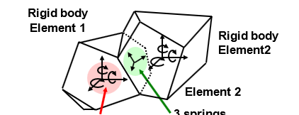

Slide 9
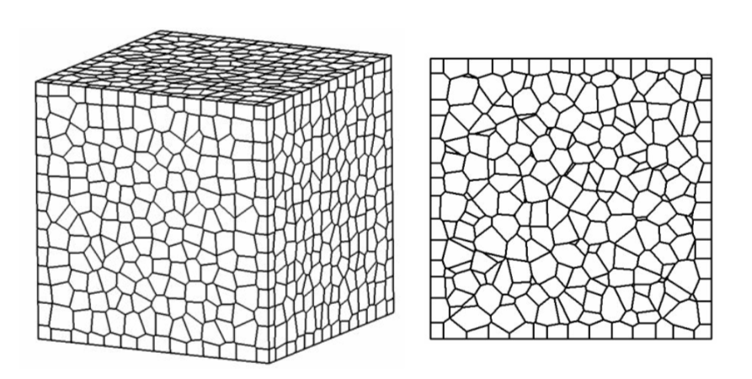
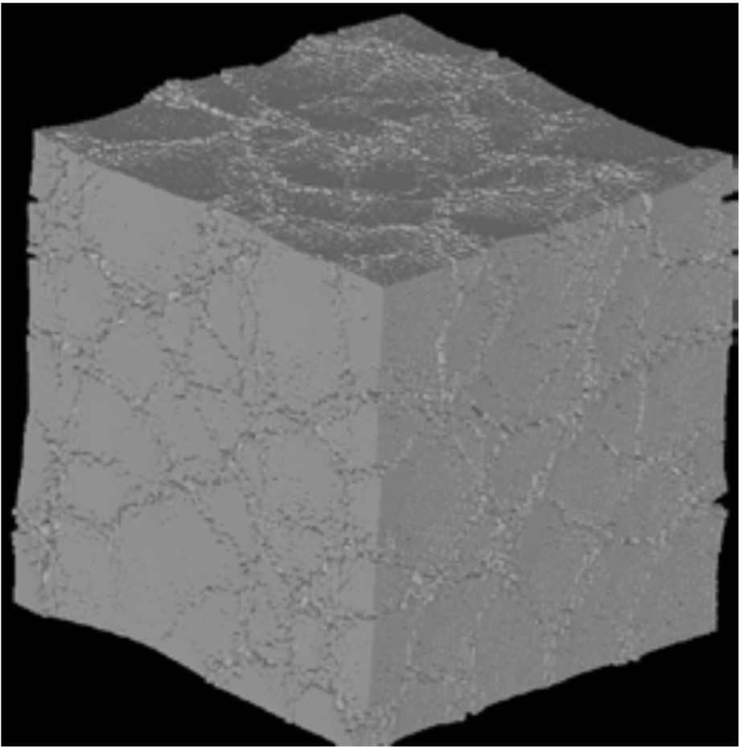
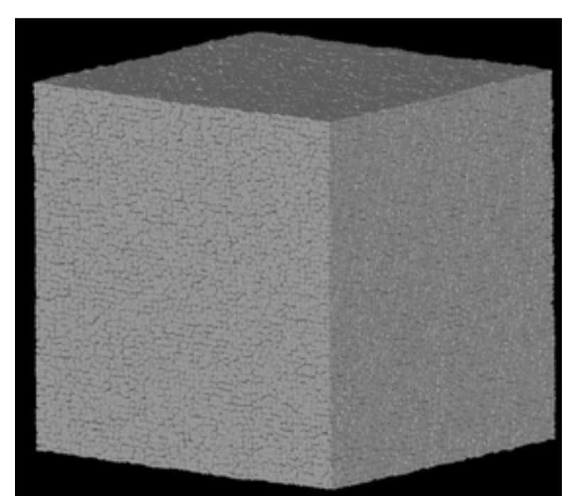
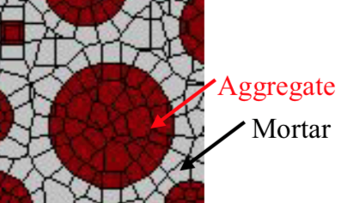
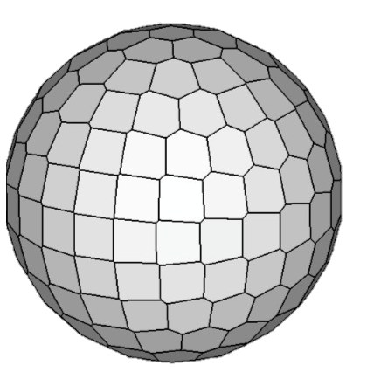
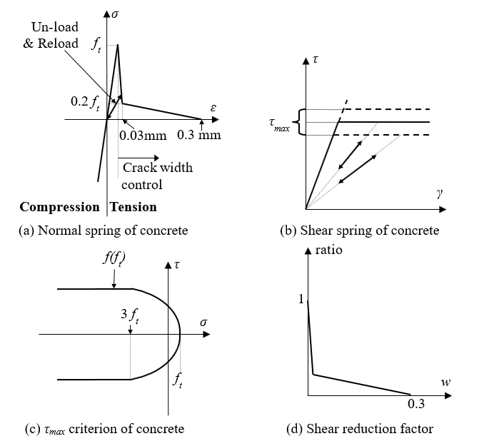
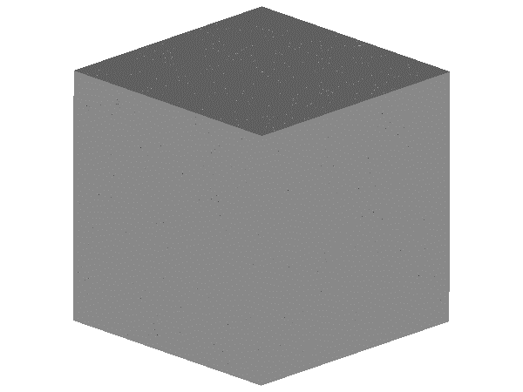
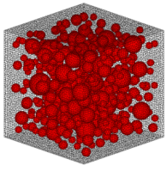
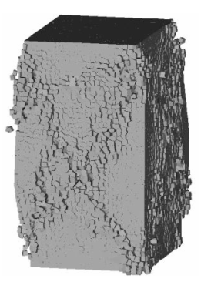
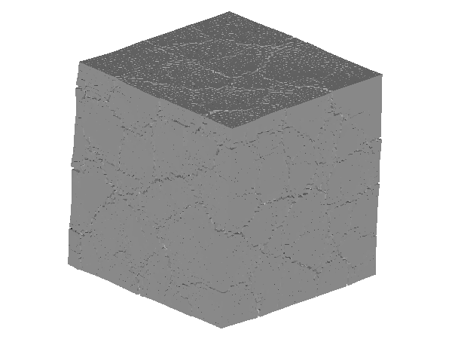
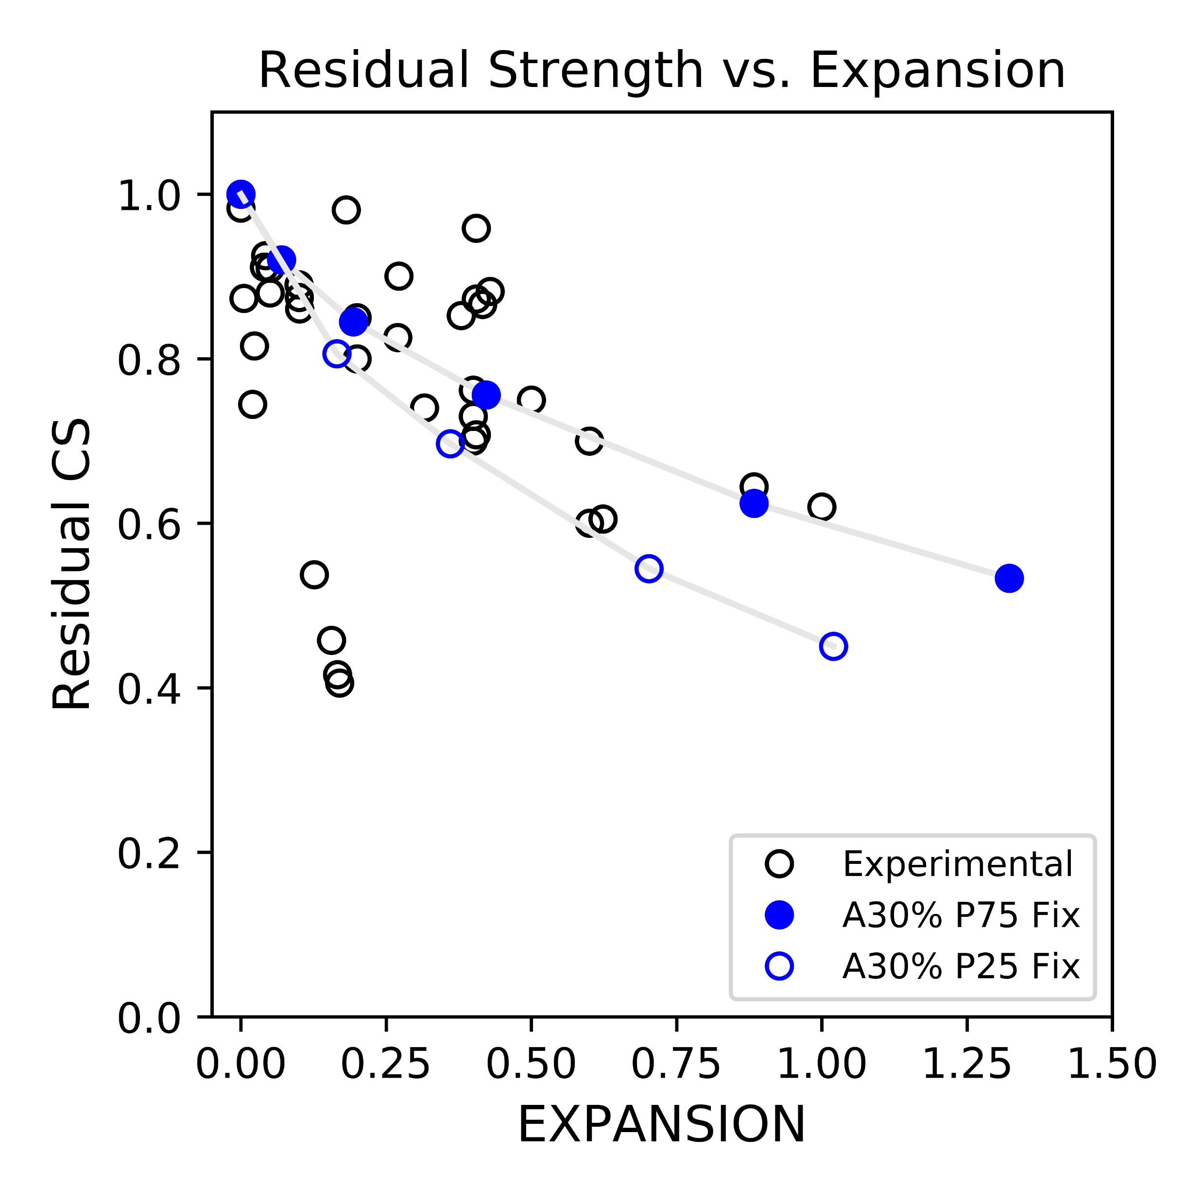
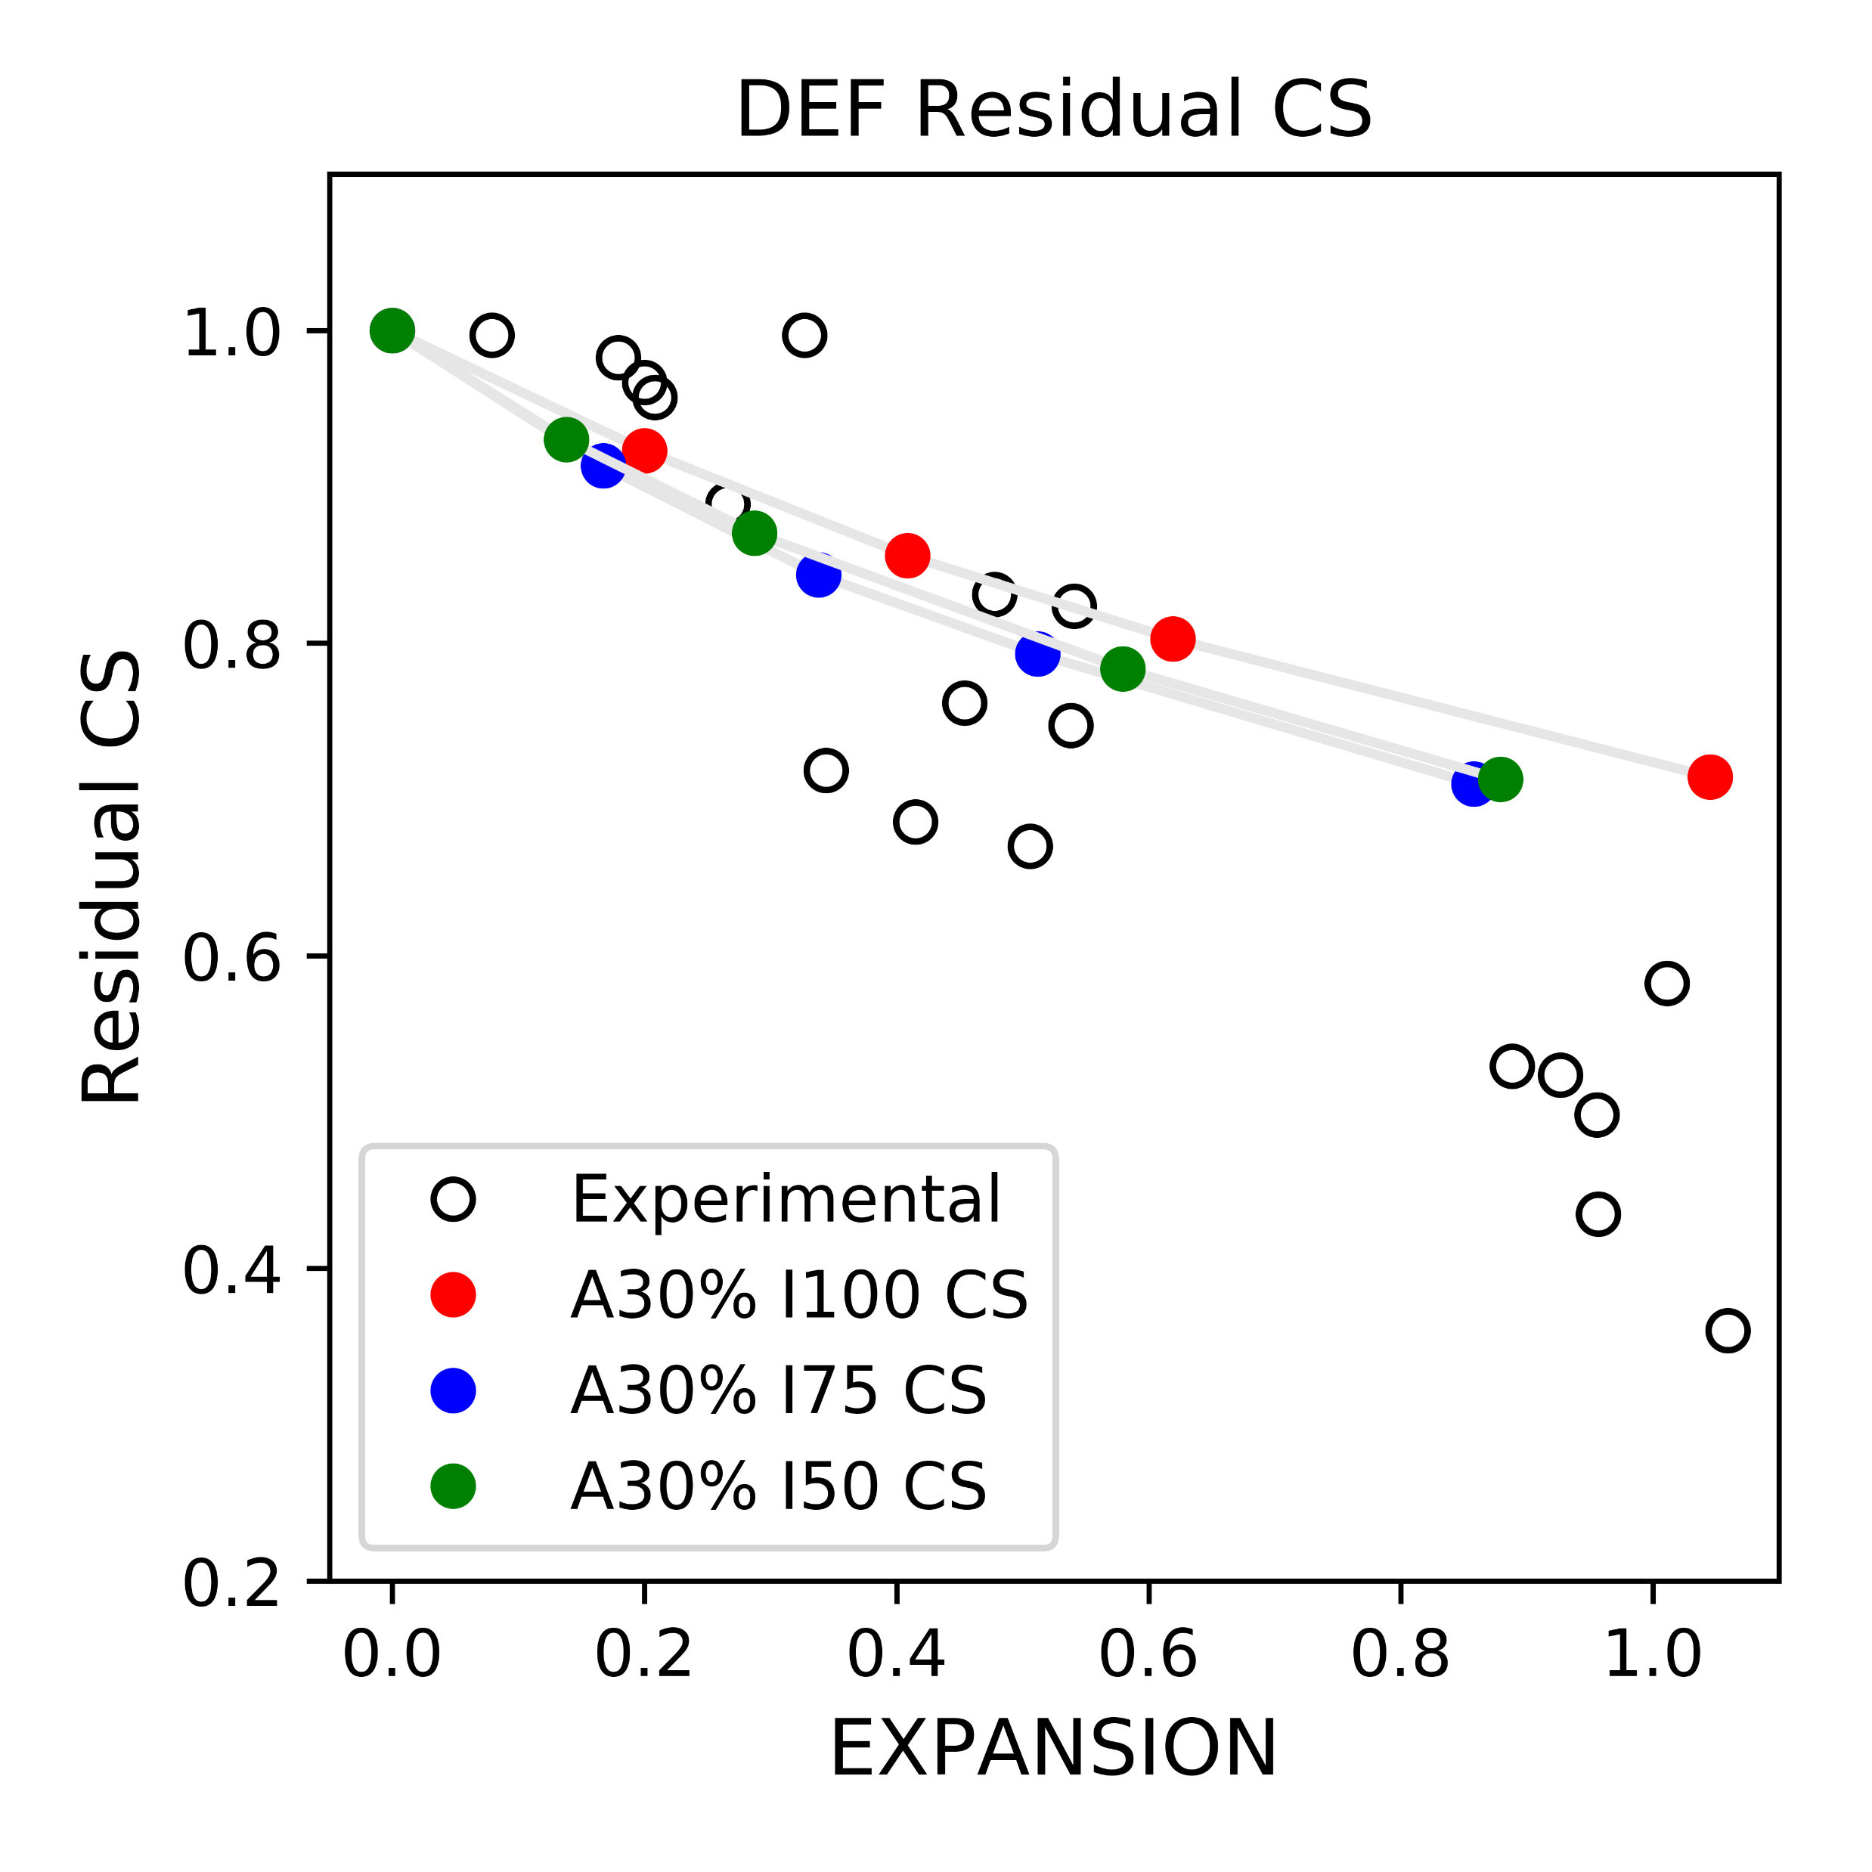
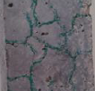
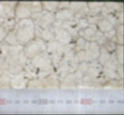
METHODOLOGY
Rigid Body Spring Model
Previous Apply in Concrete Expansion
ASR
DEF
No
Large
Crack
Map
Crack
Material Scale
Aggregate
Mortar
Micro Scale Element Behavior
Start
Rigid Body
Element 1
Constitutive Model
Elasto Plastic Model
Boundary Condition
Calculate Strain from Displacement
Calculate Stress from Strain
Rigid Body
Element 2
Calculate Force from Stress
Calculate Unbalanced Force
3 DEGREE OF
FREEDOM
1 NORMAL SPRING
2 SHEAR SPRINGS
Normal Spring
Shear Spring
RBSM is Appropriate Expansion and Residual Capacity Simulation
Mortar
Aggregate
Boundary
4
Comparing with Experimental Results
Cracking Pattern
Mechanical Properties
ASR
DEF
ASR
DEF
Map Cracking
Residual Compressive Strength
Notes:
60sec
Here we tried to Simulate these two by RBSM, to represent their expanding behavior, and analysis their residual mechanical properties
For this object, Rigid Body Spring model is a good method.
it can model aggregate and paste elements separately,
And directly formulate the behavior of all elements during expansion.
In previous research, done by Eddy san
RBSM can successfully simulate single expansion case for ASR,
But its apply in DEF is not succeed.
So here we will improve the method for DEF,
And analysis on multiple cases under different conditions of ASR to get more systemized results.

Slide 10

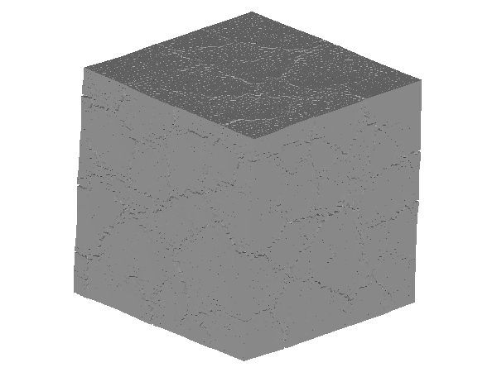
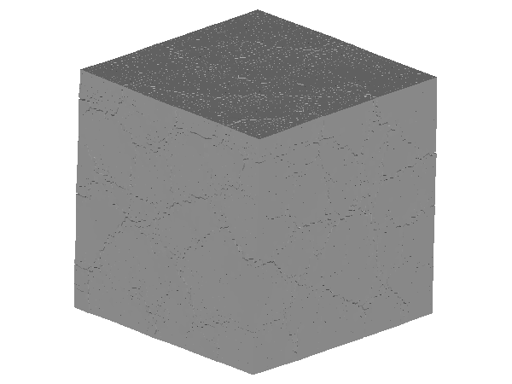
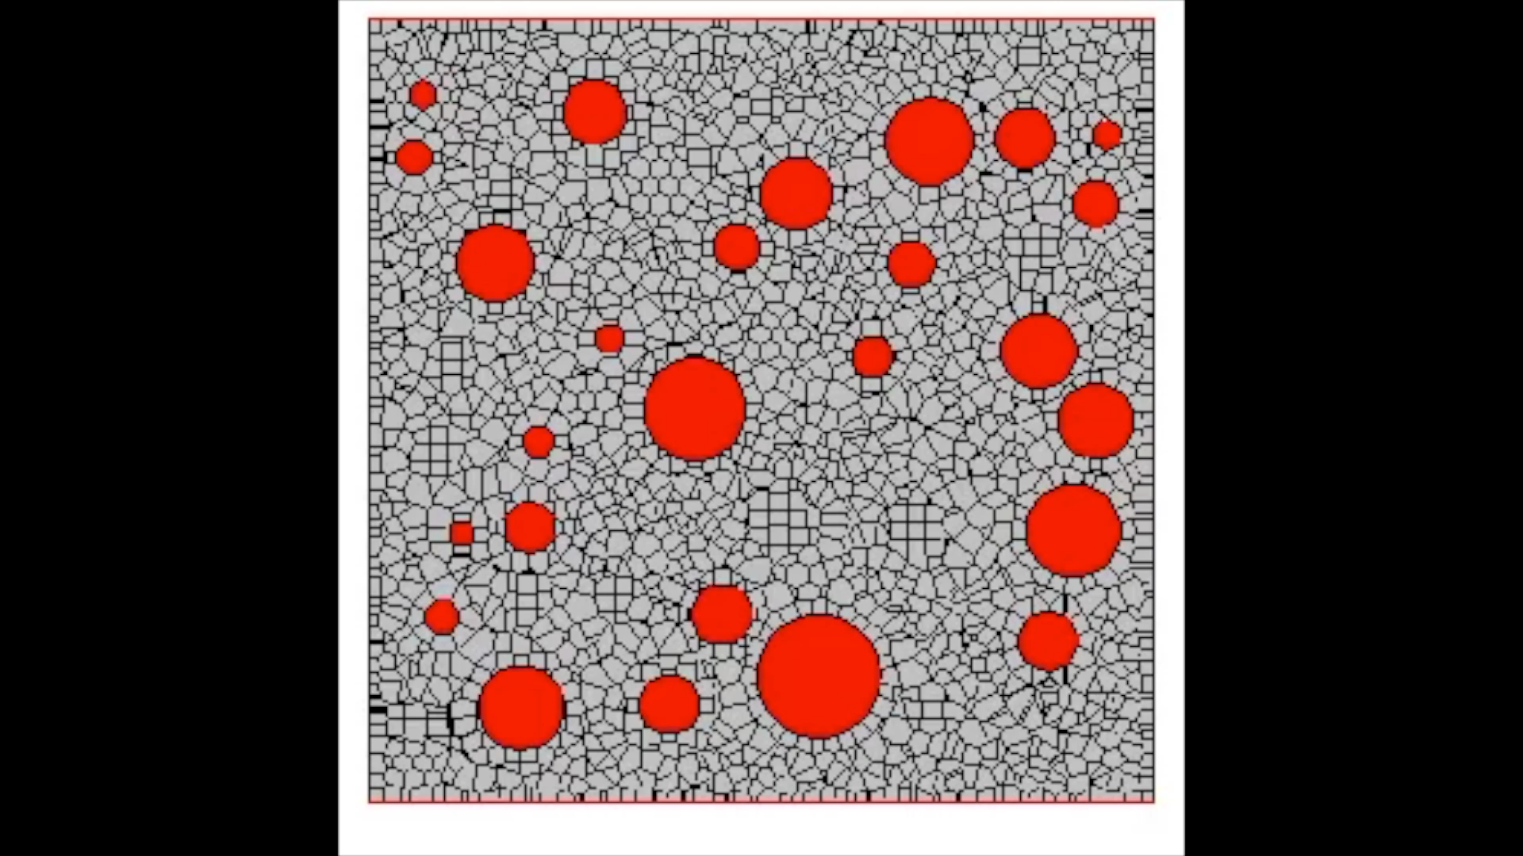
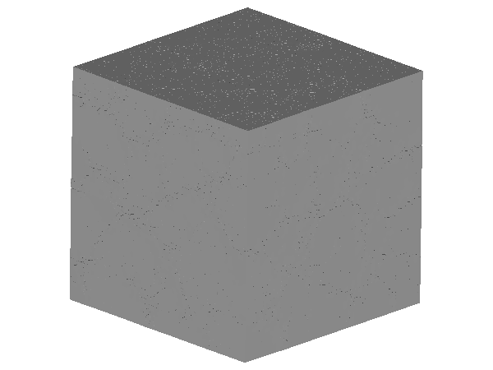
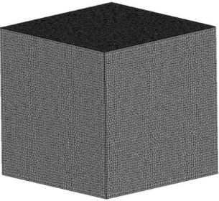
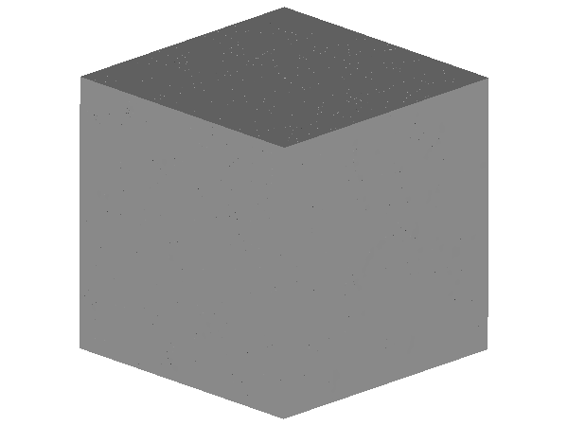

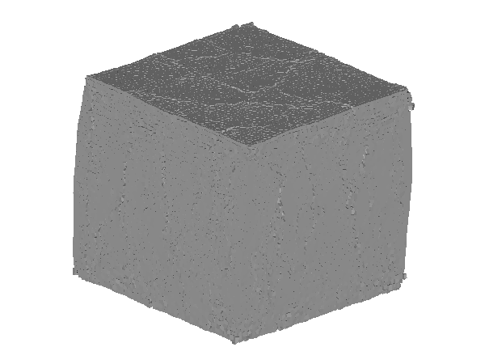












SIMULATION FLOW
MODELING
EXPANDING
LOADING
100mm
100mm
0.1%
0.3%
0.6%
14MPa
20MPa
0%
17MPa
100mm
1%
ASR
DEF
20MPa
Aggregate
Mortar
17MPa
14MPa
Mortar
Mortar
Expansion is given as initial strain between Element
Obtain Compressive Strength in Loading Test
5
Front view
Front view
Notes:
50 sec
Here I’ll introduce how our simulation is working.
First, we build 3D model, add coarse aggregate at the amount we want, and mesh the whole structure into randomized elements.
And then, the expansion is applied,
For ASR, initial strain is given between ASR reactive aggregate and paste element,
While for DEF, initial strain is given between paste and paste element
Then, we go into the uni-axial compressing test,
0.02mm displacement here is applied step by step on the top surface with fixed boundary condition,
And the compressive strength at each step will be recorded.

Slide 11


















Trail In Simplified model
10x10x10mm
Single Aggregate Model
ASR Expansion
Given 0.001 initial strain/step
Fix Boundary Loading
EXPANDING
Compression
Radial Pattern Crack
Step 1
Step 5
Step 10
Step 15
Step 20
DEF EXPANDING
Tension
Uniform
Expanse
Step 1
Step 5
Step 10
Step 15
Step 20
ASR Trail Expansion and Loading
Using 10x10x10mm Single Aggregate Model
6
0.002mm/step
Step 10
Step 20
Step 30
Step 40
Step 50
Notes:
In this page the ASR trail expansion using 10x10x10mm single aggregate model is presented.
As Initial Strain is given between aggregate and surrounding paste element, aggregate is under compressive condition during expanding.
With the distribution of inner stress, crack start to generate and deformation appeared.
Then we use the expanded model in loading simulation
In each step top boundary shift downward 0.002mm
Crack enlarged and finally it failed.

Slide 12






DEF Trail In Small size model
10x10x10mm
Single Aggregate Model
DEF Expansion
Given 0.0003 initial strain/step
Fix Boundary Loading
EXPANDING
Tension
Uniform
Expanse
Step 1
Step 5
Step 10
Step 15
Step 20
LOADING
0.002mm/step
Step 10
Step 20
Step 30
Step 40
Step 50
DEF Trail Expansion and Loading
Using 10x10x10mm Single Aggregate Model
7
Notes:
Similar trail is carried out also for DEF, giving uniformed 0.0003 initial strain in paste per step.
As Initial Strain is given here is between paste elements, aggregate is under tension in the beginning of expansion. After surrounding elements detached with aggregate due to deformation, aggregate is not under stress anymore.
Uniform expansion can be seen in the expanded paste part.
And its behavior under fixed boundary loading is similar to ASR example.

Slide 13





ASR EXPANSION RESULT
Coarse Aggregate Percentage
ASR Reactive Coarse Agg. Percentage
Final
Expansion
Result
Surface
Cracking
Pattern
~30mm
30%
25%
0.3606%
*FRONT SIDE VIEW
30%
75%
~15mm
0.4223%
*FRONT SIDE VIEW
Compare of ASR Expansion Under Different Conditions
Characteristic Map Cracking Pattern is Well Simulated
8
Notes:
50 sec
Ok. From here I’m showing our simulation result.
Firstly, ASR Expansion
Here, some different models are used, all of them size in 100 by 100 by 100 millimeter
But With different percentage of coarse aggregate and different percentage of ASR reactive coarse aggregate,
The expanded results can be different
(CLICK)
For example, if with 30% percent Aggregate, among them 25% are ASR reactive, the result would be like:
And if we increase the Reactive coarse aggregate to 75%,
It still shows the map cracking pattern, but become more compact

Slide 14





ASR EXPANSION RESULT
Map Cracking
From
Experiment
30% Aggregate
25% ASR Reactive
30% Aggregate
75% ASR Reactive
~30mm
~30mm
~15mm
400mm
Prismatic specimen of ASR expanded concrete G-B [ALKANA, 2012]
0.3606%
0.4223%
*FRONT SIDE VIEW
*FRONT SIDE VIEW
100mm
MORE REACTIVE AGGREGATE
MORE DISTRIBUTED MAP CRACKING
LESS LARGER
WIDTH CRACKS
Map Cracking Pattern related to amount of ASR Reactive Aggregate
More Reactive Coarse Aggregate Brings More Dense Map Cracking
9
More Larger Width Cracks
Notes:
60 sec
By comparing them with the ASR cracks in reality, we can see that the characteristic map cracking pattern is well presented in all three cases,
Juat the density of map patterns are different.
(POINT AT 3 Results)
So what’s the tendency here?
If we calculate the volume percentage of reactive aggregate, it will be more clear that
(Click)
With more reactive ASR aggregate in the model, the cracking pattern will be more compact.
This may also gives us an idea on analyzing the ASR in real world without disassemble them.

Slide 15








DEF EXPANSION RESULT
15%
50%
75 °C
STEAM CRUING PROCESS
Uniformed Expansion
Sleeper
>85 °C
Temperature
More
Expanse
Higher
Temp
STEAM CHAMBER
NO
CRACKING
Steam
Aggregate Percentage
Expansion Intensified Range
30%
50mm
75mm
100mm
100x100x100mm
Introducing Un-uniformly Expansion for DEF Center part
where experienced higher temperature expand more
10
Notes:
70 sec
Next, we will go into the expansion of DEF
In previous study, simple uniformly paste expansion does not succeed,
Which means that we have to find another way around.
(CLICK)
In research of DEF expansion happens in Indian railway sleepers,
Anupum recorded the temperature of speciment during steam curing,
From his result, when the outer temperature is ideal,
The inner part temperature is significantly higher.
(CLICK)
As DEF is closely related to maximum curing temperature,
the inner part of structure should suffer more from DEF expansion
(Click)
So
Here we made models for
(point agg)
15% aggregate case and 30 % case
And set different range of DEF expansion intensified zone,
From 50 by 50 by 50mm inside to uniformly overall expansion, for comparing

Slide 16





DEF EXPANSION RESULT
30% Aggregate
50x50x50mm
30% Aggregate
75x75x75mm
30% Aggregate
100x100x100mm
~25mm
~25mm
100mm
0.5118%
0.5795%
0.6191%
100mm
*FRONT SIDE VIEW
*FRONT SIDE VIEW
*FRONT SIDE VIEW
100mm
Characteristic Map Cracking
No Obviously Large Cracks
Map Cracking From Experiment
~25mm
Specimens of DEF expanded concretes KAWABATA et al., 2011
30%
100x100x400mm
DEF Expansion Under Different Conditions
Characteristic Map Cracking Pattern is Well Simulated
11
Notes:
15 sec
And here we can see,
While the uniformed overall expansion does not show crack
map cracking patterns are shown in all center intensified cases,
(point at 50, 75)

Slide 17






ASR LOADING RESULT
30% Aggregate
75% ASR Reactive
0%
0.14%
0.29%
0.58%
0.89%
1.32%
*FRONT SIDE VIEW
Compressive Strength Gradually Reduced when Expansion Increase
Simulation Result Close to Experimental Result
12
Notes:
40 sec
Next, uni-axial compressive test is carried out on expanded models
Firstly, ASR
for model with 30% coarse aggregates, 75% of which are set to be ASR reactive
We can get the remain compressive strength comparing to non-damaged one
Of the cases expanded from 0% to 1.3%
The compressive strength is gradually decreasing as we increase the global expansion.
this result is also close to some of the experimental results.

Slide 18





ASR LOADING RESULT
ASR Reactive
Aggregate Percentage
30% Aggregate
75% ASR Reactive
0.89%
30% Aggregate
25% ASR Reactive
20% LESS
CPMPRESSIVE STRENGTH
0.70%
Residual Ratio of Compressive Strength Decrease when
Decrease the Ratio of Reactive Aggregate
13
Notes:
15 sec
And for ASR reactive aggregate percentage,
If we choose 25% of them to be ASR reactive, not 75%,
Compressive strength generally decrease by 20%

Slide 19




DEF LOADING RESULT
30%
50mm
*FRONT SIDE VIEW
0%
0.14%
0.29%
0.58%
0.88%
Compressive Strength Gradually Reduced when Expansion Increase
Simulation Result Close to Experimental Result
14
Notes:
30 sec
Similar loading test is also done on DEF expanded models
with 50x50x50 inside zone giving intensified DEF expansion,
(click)
We can also see the decreasing trend of compressive strength when we introduce larger expansion,
Which is also close to some of the experimental results

Slide 20


DEF LOADING RESULT
0.62%
Expansion Intensified Zone
VERY CLOSE
CPMPRESSIVE STRENGTH
30%
0.51%
100mm
30%
0.57%
75mm
50mm
30%
Residual Ratio of Compressive Strength Does not Change Much
When Changing DEF Intensified Expanding Zone
15
Notes:
30sec
However, though changing the inner zone where expansion intensified significant changed the cracking behavior,
It does not have large impact on the compressive strength.
The residual compressive strength in all three series of cases are very close.

Slide 21






COMPARE BETWEEN ASR AND DEF
Different in Stress Distribution
Different in Crack Distribution
ASR
DEF
ASR
DEF
Residual Property vs Expansion
Residual Property vs Crack Number
Inconsistent in
ASR and DEF cases
DEF
Consistent in All Cases
ASR
Number of cracked interfaces 0.01mm+
Residual Compressive Strength Ratio is close related to
Number of Large Width cracked interfaces
16
Notes:
80 sec
By cross comparing the simulation result of ASR and DEF
We can see that there are many differences among them,
Such as inner stress distribution
Crack distribution
And the residual mechanical properties are not change in the same ratio with changing of global expansion.
Does this mean there is no common used relationship between their expansion behavior and residual mechanical properties?
Nope.
General relationships is found between the number of cracked interfaces which larger than 0.01mm and the residual compressive strength.
With grater number of large crack, for here we used 0.01mm, the residual compressive strength almost linearly decreased, in all ASR and DEF cases.
Which implies that the residual compressive strength may not determined by global expansion ratio, but the large cracks generated during the expanding procedure.

Slide 22


CONCLUSION
Expansion Behavior
Mechanical Properties
Our Simulation can roughly simulated the Damage caused by expansion in Residual Compressive Strength
Expansion Caused by Different Mechanism have Significant different Residual Mechanical Properties
Loss in Residual Property is closely related to Number cracks, especially larger cracks
ASR Expansion Map Cracking Pattern Simulation
DEF Expansion Map Cracking Pattern Simulation
ASR
DEF
Characteristic Map Cracking
*FRONT SIDE VIEW
17
Further Simulation on Quantitively Analysis of Expansion Behavior
Help Nondestructive Evaluation for Expanded structure in Future
Notes:
80sec
In conclusion, our simulation by RBSM is a suitable choice for ASR and DEF expansion.
In both ASR and DEF case, characteristic map cracking pattern is represented
Damage in compressive strength is simulated and close to some of the experimental results.
By comparing between expensed cases with different mechanism, we can see the residual mechanical properties also changed significantly
Finally, the relationship between Residual Compressive strength and number of wider cracked interface are confirmed. In same global expansion ratio, with more concentrated crack, loss in mechanical property will be much severe.
And hope this research could help the non-destructive evaluation of ASR and DEF damaged concrete structure, predict their residual capability of serving.

Slide 23
Thank you for listening
18

